Slide 1
Using the Qualifying Child Charts
Why and How

Slide 2
Why?
An easy tool for a
clear, comprehensive
answer

Slide 3
Why not just dependency rules?
If we interview taxpayers with just the dependency rules in front of us,
And a family or household member isn’t a dependent,
We may forget to include him or her on the tax return...
...even when he should be included as a non-dependent for EIC, DC, or other benefits.

Slide 4
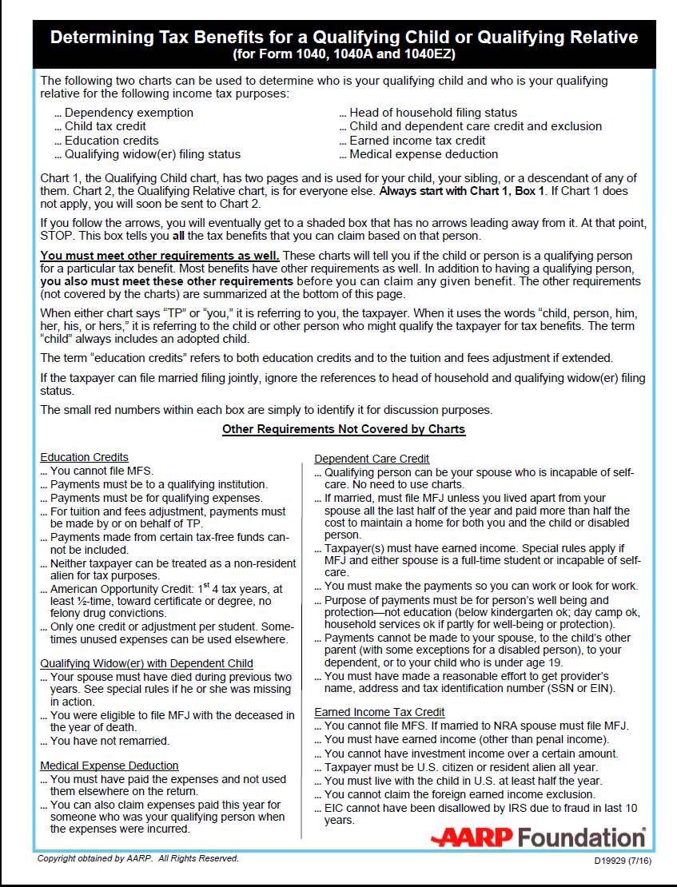
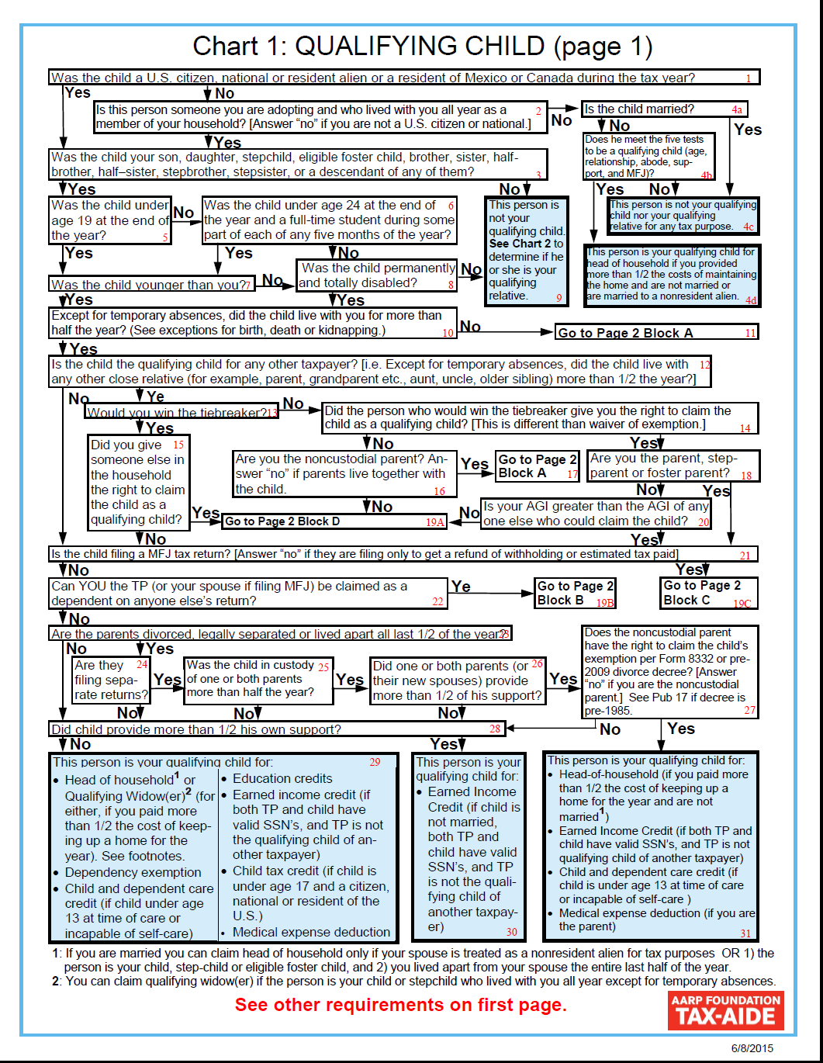
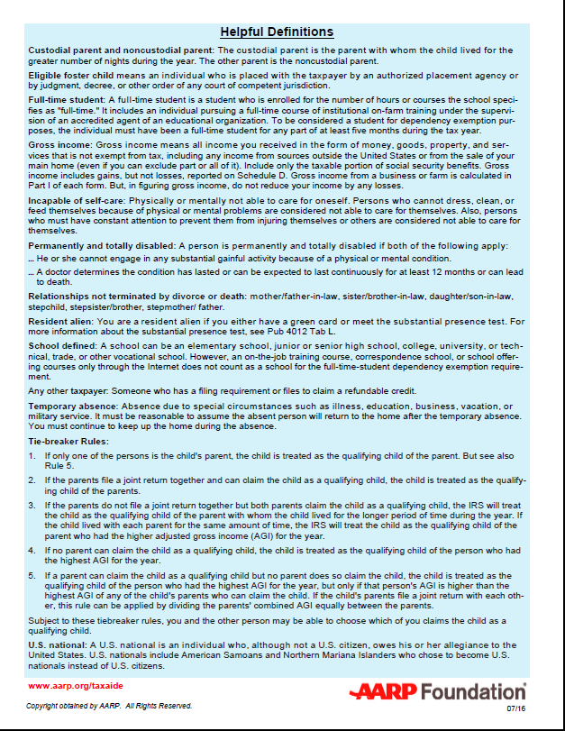
Laminated Tri-Fold
Notes:
How many use a chart for single or MFJ?

Slide 5
Qualifying Child Tri-Fold
Simplifies
  Determining Filing Status
  Identifying qualifying persons
To eliminate mistakes that otherwise might not ever be caught or corrected

Slide 6
Qualifying Child Charts
How to Use Them?

Slide 7
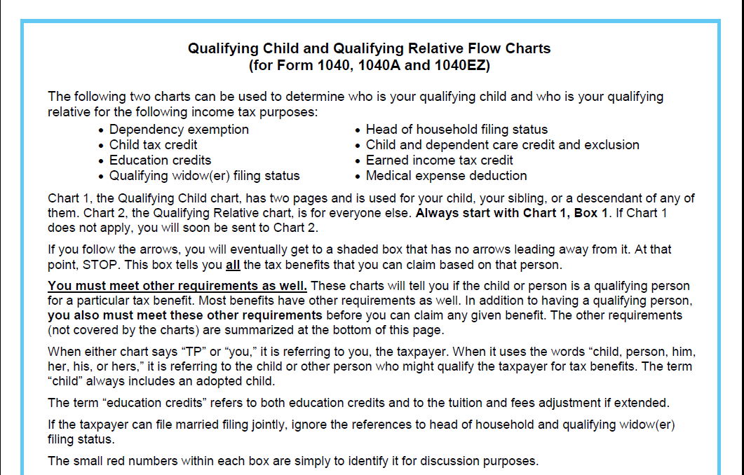
Read the Introductory Page
Notes:
Covers eight tax benefits. Does not cover student loans.
Charts tell if you have a qualifying child, but there are also OTHER REQUIREMENTS.
Taxpayer is referred to as “you.” Child or other person is referred to as “him” or “her.”

Slide 8

Terms You Need to Know
(See back of laminated tri-fold)
Custodial and noncustodial parent
Eligible foster child
Full-time student
Gross income
Incapable of self-care

Slide 9
Terms You Need to Know
(See back of laminated tri-fold)
Permanently and totally disabled
Relationships not terminated by divorce or death
Resident alien
School defined

Slide 10

Terms You Need to Know
(See back of laminated tri-fold)
Any other taxpayer
Temporary absence
Tie-breaker Rules
U.S. national

Slide 11
Start with Qualifying Child Chart
Use one taxpayer (or a taxpayer couple if filing MFJ) – referred to as “you”
And one child or other person – referred to as “him” or “her”
Use the child’s name when asking the questions
Notes:
If taxpayer is filing MFJ, questions refer to either the taxpayer or spouse

Slide 12
Use the Child’s Name
If the child’s name is Joe, start at Box 1 and ask, “Was Joe a U.S. citizen or national or a resident of the U.S., Mexico or Canada for some part of the tax year?”

Slide 13
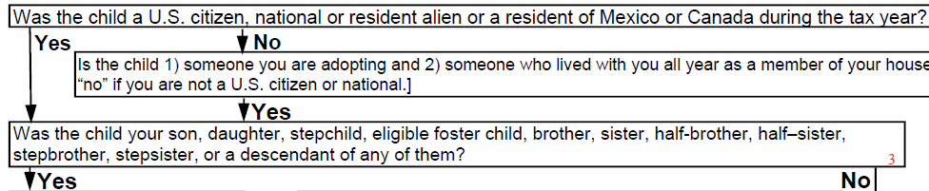
Follow the arrows
If the answer to the question in Box 1 is “yes,” follow the yes arrow to Box 3.

Slide 14
Box 3
Ask, “Was Joe your son, daughter, stepchild, eligible foster child, brother, sister, half-brother, half-sister, stepbrother, stepsister, or a descendant of any of them?”

Slide 15
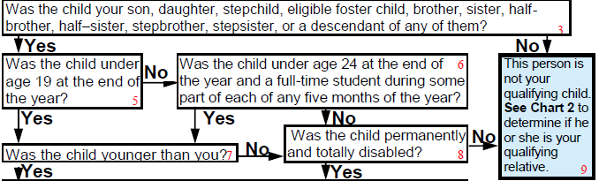
Follow the arrows
If the answer to the question in Box 3 is “yes,” follow the yes arrow to Box 5.
And ask the question in Box 5

Slide 16
Blue boxes
When you get to a blue box, STOP.
The blue box lists ALL the benefits for which this child qualifies the taxpayer.
Read the whole box. Important information is included in parentheses after most benefits.

Slide 17
Repeat for Other Children
If there is an additional child (or household or family member)
Whose situation is different,
You may get to a different blue box.

Slide 18
Start with the middle generation
If the household has multiple generations, don’t start with the grandchildren, start with the children.
You’ll need to determine if they ARE dependents before you can determine if they HAVE dependents.

Slide 19
Start with Qualifying Child Chart
Even if you are analyzing a person who is not a qualifying child, start with the Qualifying Child Chart (Chart 1). You will be directed to the Qualifying Relative Chart (Chart 2) if appropriate.
It is easy to mistake the child of a non-custodial parent as a qualifying relative. Start with the Qualifying Child Chart.

Slide 20
It looks very complicated, but...
If your child’s situation is straight- forward, the chart will take you straight down the left-hand side to Box 29.
These are the same 10 questions you would answer from Page C-3 of the Resource Guide

Slide 21

Citizenship?
Relationship?
Age?
Younger than you?
Residency?
Child of more than
one taxpayer?
Child filing MFJ?
Can you be claimed as a dependent?
Parent separated and filing separate returns?
Did the child provide more than ½ of his own support?
Then, person is qualifying
child for all possible benefits

Slide 22
If situation is not straight-forward
Follow the arrows and you will arrive at the correct answer

Slide 23
Example 1
Child (John) is self-supporting (because he receives social security survivor benefits used for his support).

Slide 24
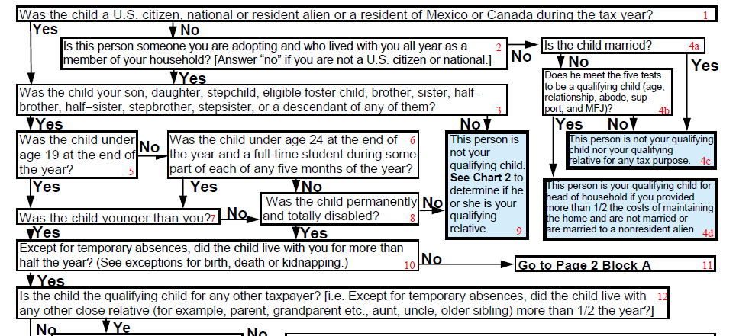
Start with John as QC of parents
Ask: Was John a US citizen or national or a resident alien of the US, Mexico or Canada for some part of the tax year?
Ask: Was John your son, daughter, stepchild, eligible foster child, brother, sister, half-brother, half-sister, stepbrother, stepsister, or a descendant of any of them?
Ask: Was John under age 19 at the end of the year
Ask: Was John younger than you?
Ask: Except for temporary absences, did John live with you for more than half the year? (See exceptions for birth, death or kidnapping.)
Ask: Is John the qualifying child for any other taxpayer? [i.e. Did John live with any other close relative (for example, parent, grandparent etc., aunt, uncle, older sibling)] for more than ½ the year?

Slide 25
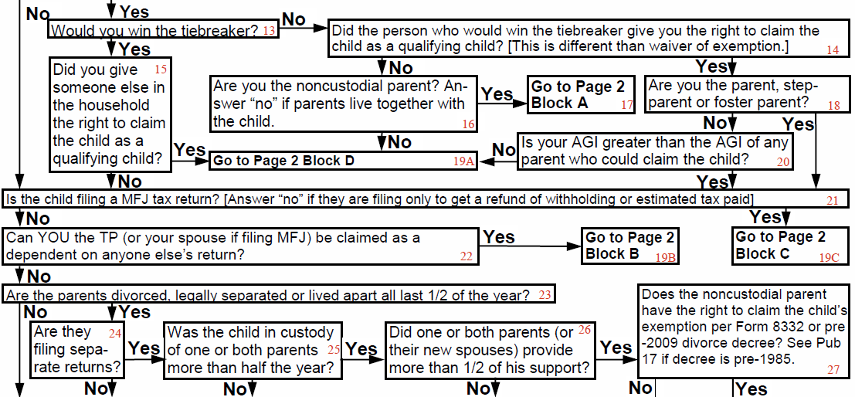
Continue with John as QC of parents
Ask: Is John filing a MFJ tax return? [Answer “no” if filing only to get a refund of withholding or estimated tax paid.]
Ask: Can you, the TP, be claimed as a dependent on anyone else’s return?
Ask: Are John’s parents divorced, legally separated or lived apart all last ½ of the year?

Slide 26
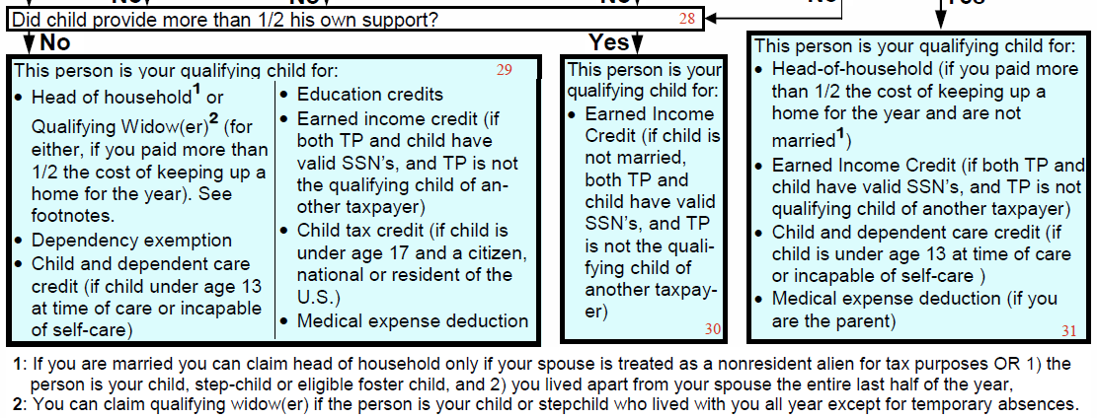
Continue with John as QC of parents
Ask: Did John provide more than ½ his own support?
John is your qualifying child for earned income credit IF
He is not married,
Both you and he have valid SSNs, and
You are not the qualifying child of another taxpayer.

Slide 27
Continue with John as QC of parents
But note:
No head of household
No dependency exemption
No child tax credit, etc.

Slide 28

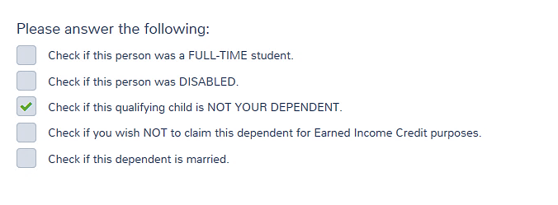
Enter John in the Dependents Section
Not a dependent, but yes for EIC

Slide 29
Example 2
The Taxpayer (Al) paid medical expenses for his live-in girl friend (Ann) who is NOT his dependent (gross income too high).

Slide 30
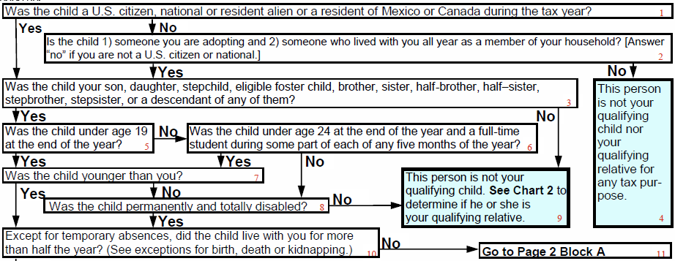
Start with Ann as QC of Al
Is Ann a U.S. citizen or national or a resident of the U.S., Mexico or Canada for some part of the tax year?
Was Ann your son, daughter, stepchild, eligible foster child, brother, sister, half-brother, half-sister, stepbrother, stepsister, or a descendant of any of them?
Ann is not your qualifying child. See Chart 2 to determine if she is your qualifying relative.

Slide 31
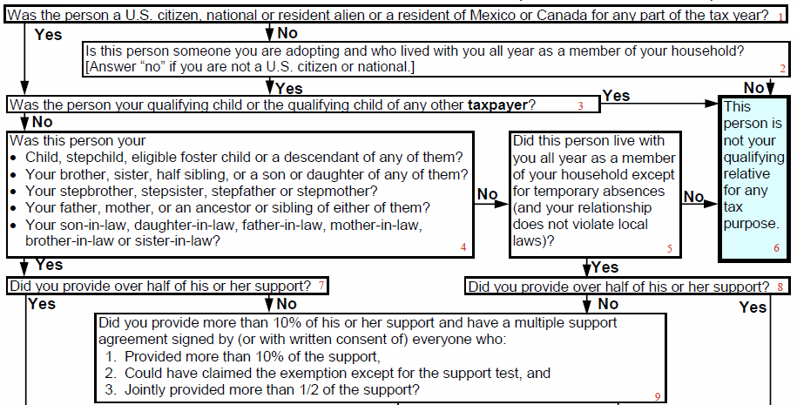
Continue with Chart 2 (Ann as QR of Al)
Was Ann your
Child, stepchild, eligible foster child or a descendant of any of them?
Your brother , sister, half-sibling or a son or daughter of any of them?
Your stepbrother, stepsister, stepfather or stepmother?
Your father, mother, or an ancestor or sibling of either of them?
Your son-in-law, daughter-in-law, father-in-law, mother-in-law, brother- in- law or sister-in-law?
Was Ann a US citizen, national or resident alien or a resident of Mexico or Canada for any part of the year?
Was Ann your qualifying child or the qualifying child or any other taxpayer?
Did Ann live with you all year as a member of your household except for temporary absences (and your relation-ship does not violate local laws)?
Did you provide over half of Ann’s support?
Let’s say those laws have been struck down in your state.

Slide 32
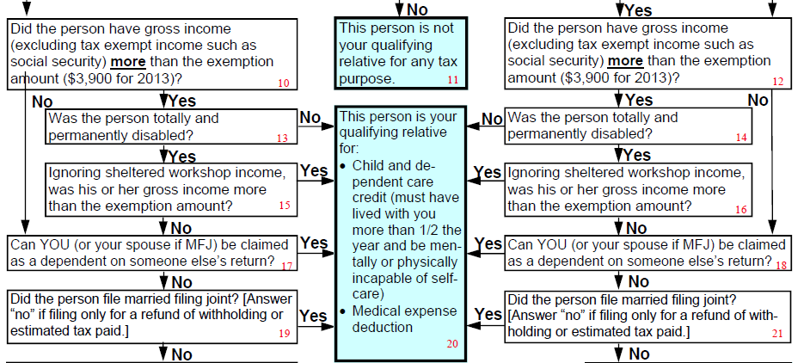
Continue with Chart 2 (Ann as QR of Al)
Did Ann have gross income (excluding tax exempt income such as social security) more than the exemption amount?
Was Ann totally and permanently disabled?

Slide 33
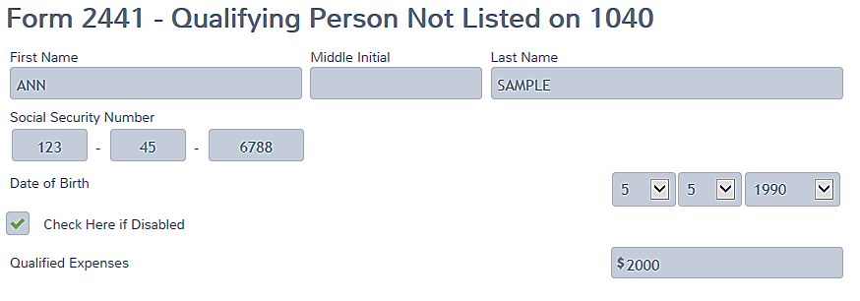
Input
If Al paid Ann’s qualified dependent care expenses, enter in Credits Section):
TaxSlayer uses “Disabled” instead of “incapable of self-care.”

Slide 34
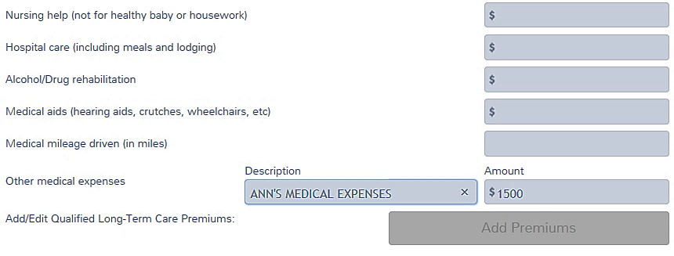
Input
If Al paid Ann’s qualified medical expenses—enter as itemized deduction:

Slide 35
If situation is not straight-forward
Example 3: Taxpayer (Tom) pays child support and pays for medical insurance for his child (Billy), but his ex-wife won’t sign Form 8332.

Slide 36
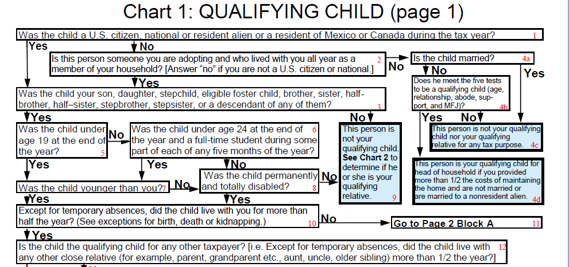
Start with Billy as QC of Tom
Ask: Was Billy a US citizen or national or a resident alien of the US, Mexico or Canada for some part of the tax year?
Ask: Was Billy your son, daughter, stepchild, eligible foster child, brother, sister, half-brother, half-sister, stepbrother, stepsister, or a descendant of any of them?
Ask: Was Billy under age 19 at the end of the year?
Ask: Was Billy younger than you?
Ask: Except for temporary absences, did Billy live with you for more than half the year? (See exceptions for birth, death or kidnapping.)
Go to Page 2 Block A

Slide 37
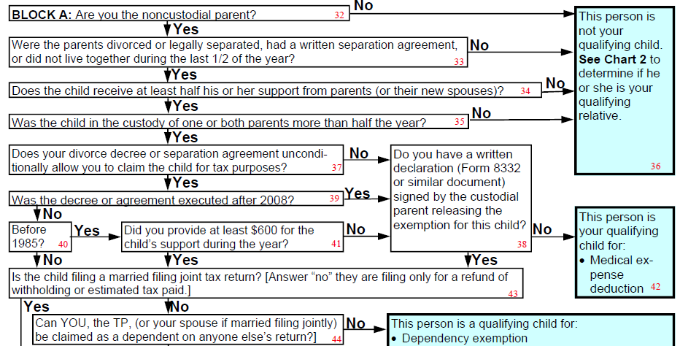
Continue in Block A (Billy as QC of Tom)
Are you the noncustodial parent?
Were the parents divorced or legally separated, had a separate maintenance agreement, or did not live together during the last ½ of the year?
Does Billy receive at least half his support from parents or their new spouses?
Was Billy in the custody of one or both parents more than half the year?
Does your divorce decree or separation agreement unconditionally allow you to claim Billy for tax purposes?
Do you have a written declaration (Form 8332 or similar document) signed by the custodial parent releasing the exemption for Billy?

Slide 38
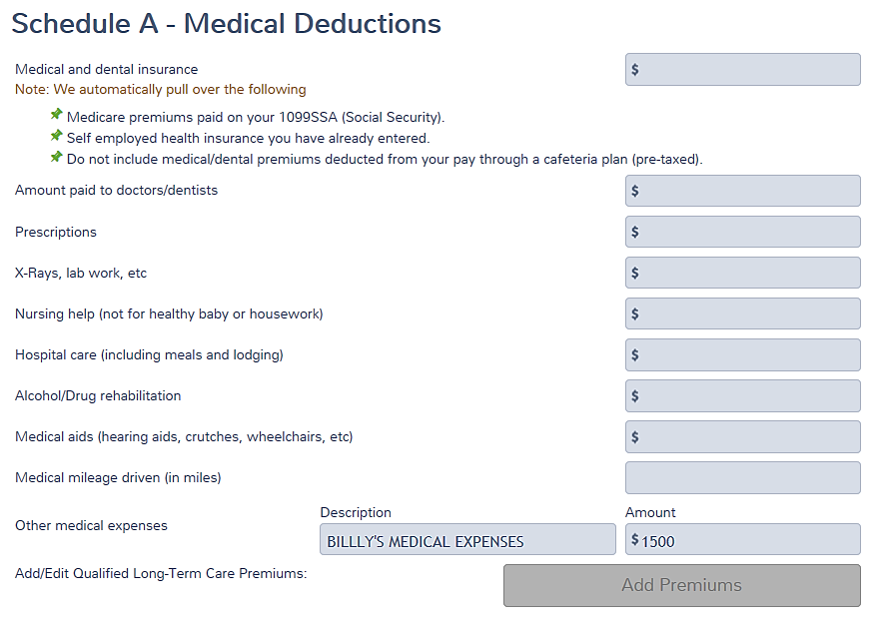
Billy
Can claim medical on Sch A:

Slide 39
Example 4:
Mary has a baby (Lele). Mary and Lele live with Mary’s parents while Mary continues with high school.
Support agreement requires baby’s father (Sam) to pay $200/month in child support and gives him the child’s tax exemption.
Sam wants to claim Lele’s exemption.

Slide 40
Example 4 Continued:
Mary’s parents are providing room and board for Lele (about $1,000/mo) and think they should be able to claim her exemption.
Mary believes Sam is entitled to claim the exemption but is willing to give to her parents whatever would be hers.

Slide 41
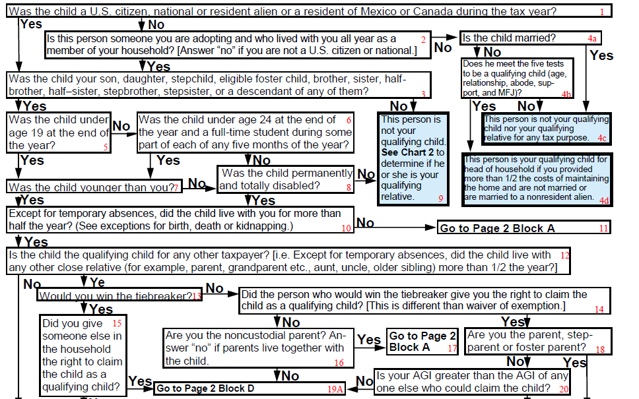
Start with Lele as QC of Sam
Was Lele a US citizen, national or resident alien or a resident of Canada or Mexico for any part of the year?
Was Lele your daughter?
Was Lele under age 19 at the end of the year?
Was Lele younger than you?
Except for temporary absences, did Lele live with you for more than half the year?
Go to Page 2 Block A

Slide 42
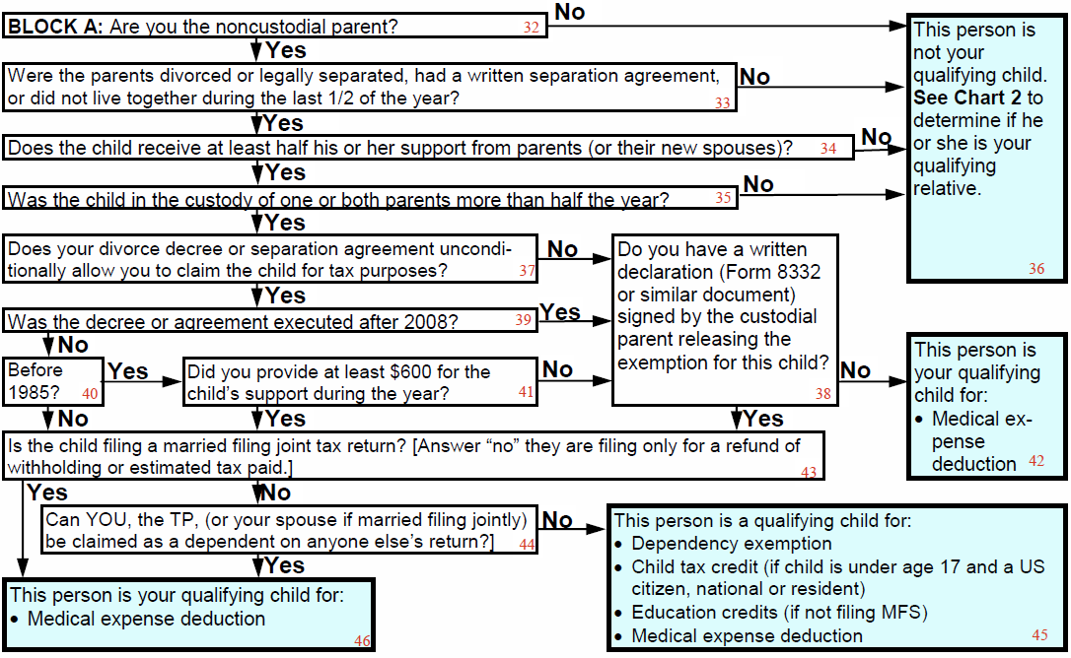
Go to Block A (Lele as QC of Sam)
Are you Lele’s noncustodial parent?
Are the parents divorced, legally separated, had a written separation agreement, or did not live together during the last ½ of the year?
Did Lele receive at least half of her support from parents (or their new spouses)?
Before we do that, let’s see if Lele is the qualifying child of any other taxpayer.

Slide 43
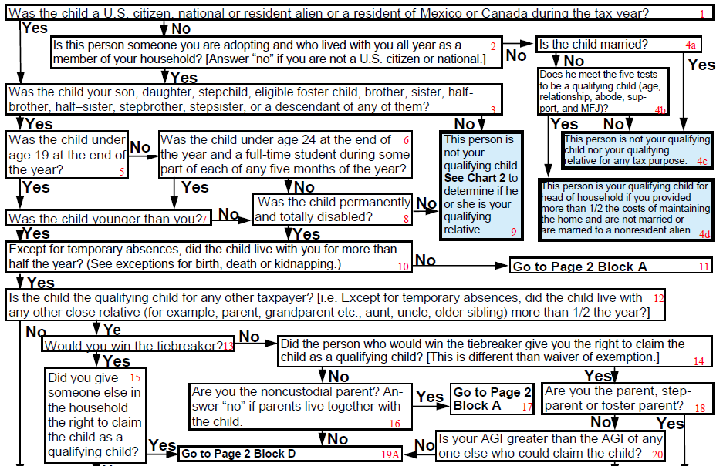
What is Mary’s Situation?
Is she the QC of her parents?
Is Mary a US citizen?
Is Mary your son, daughter, stepchild, eligible foster child, brother, sister, half-brother, half-sister, stepbrother, stepsister, or a descendant of any of them?
Was Mary under age 19 at the end of the year?
Was Mary younger than you?
Except for temporary absences, did Mary live with you for more than half the year?
Is Mary the qualifying child of any other taxpayer?
Notes:
Lele’s mother, Mary, would win the tiebreaker.

Slide 44
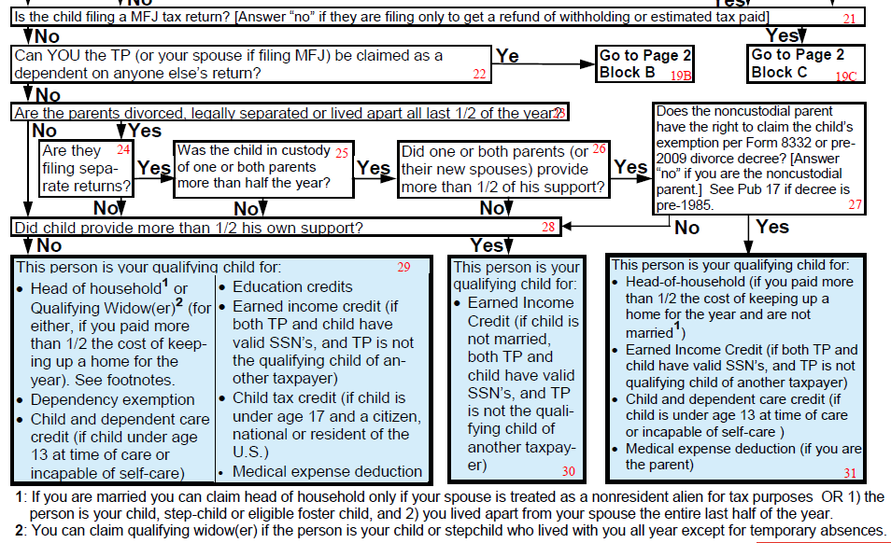
Continue with Mary as QC of her Parents
Include Mary in Dependents Section of parents’ return
Is Mary filing a MFJ tax return?
Can you be claimed as a dependent on anyone else’s return?
Are Mary’s parents divorced, legally separated or lived apart all last ½ of the year?
Did Mary provide more than ½ her own support?

Slide 45
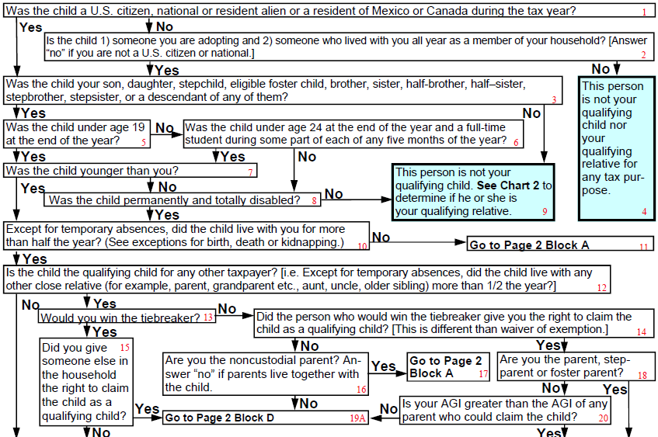
Check: Lele as QC of Mary
Is Lele a US citizen?
Is Lele your son, daughter, stepchild, eligible foster child, brother, sister, half-brother, half-sister, stepbrother, stepsister, or a descendant of any of them?
Was Lele under age 19 at the end of the year?
Was Lele younger than you?
Except for temporary absences, did Lele live with you for more than half the year?
Is Lele the qualifying child for any other taxpayer?
Would you win the tie-breaker?
Did you give someone else in the household the right to claim the child as a qualifying child?
Let’s see what happens if we say “no”
Notes:
Lele is probably the qualifying child of Mary’s parents

Slide 46
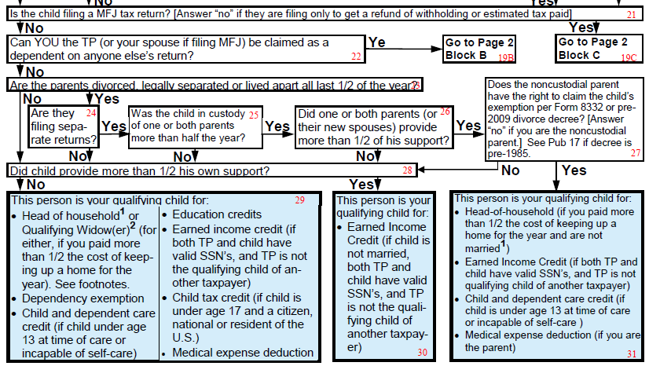
Continue with Lele as QC of Mary
Is Lele filing a MFJ return?
Can Mary be claimed as a dependent?
Go to Page 2 Block B

Slide 47
Continue with Lele as QC of Mary
Did Lele provide more than ½ her own support?
HoH—but Mary didn’t provide ½ the cost of the home
Dependent care credit (if Lele is incapable of self-care)
EIC—but Mary is a QC so no EIC
Medical expenses
Mary will give her parents the right to claim Lele.

Slide 48
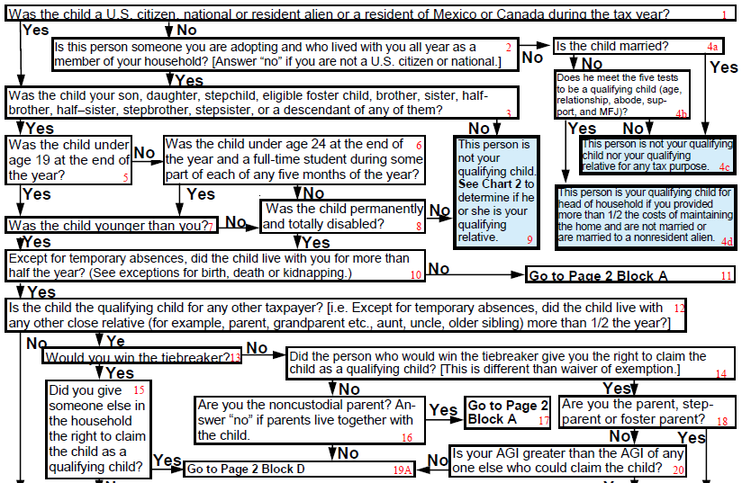
Check: Lele as QC of the Grandparents
Is Lele a US citizen?
Is Lele your son, daughter, stepchild, eligible foster child, brother, sister, half-brother, half-sister, stepbrother, stepsister, or a descendant of any of them?
Was Lele under age 19 at the end of the year?
Was Lele younger than you?
Except for temporary absences, did Lele live with you for more than half the year?
Is Lele the qualifying child of any other taxpayer?
Would you win the tie-breaker?
Did Mary give you the right to claim Lele as a QC?
Are you Lele’s parent, step-parent or foster parent?
Is your AGI greater than Mary’s?
Let’s say Mary has investment income that gives her a filing requirement and makes her a taxpayer.
Notes:
Let’s say Mary has some investment income that gives her a filing requirement and makes her a taxpayer.
Lele’s mother, Mary, would win the tiebreaker if she was a taxpayer, but she’s agreed to give her parents any tax benefits that would be hers.

Slide 49
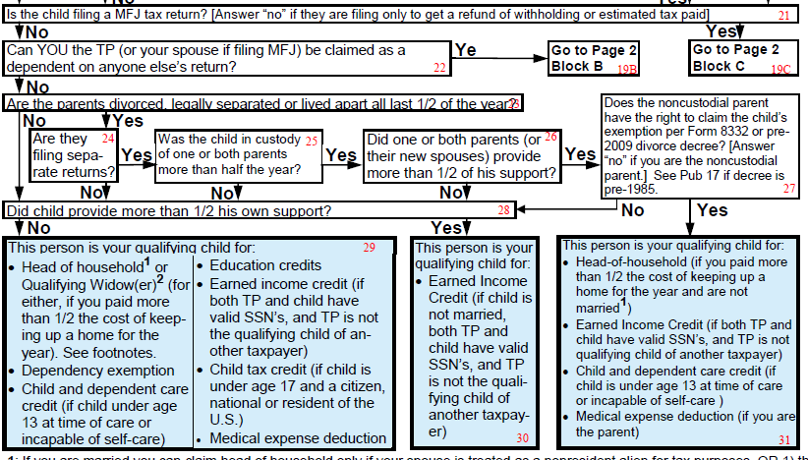
Continue with Lele as QC of Grandparents
Include Lele in Dependents Section of grandparents’ return
Is Lele filing a MFJ tax return?
Can you be claimed as a dependent on anyone else’s return?
Are Lele’s parents divorced, legally separated or lived apart all last ½ of the year?
Are they filing separate returns?
Was Lele in the custody of one or both parents more than half the year?
Did one or both parents provide more than ½ of Lele’s support?
Did Lele provide more than ½ of her own support?

Slide 50
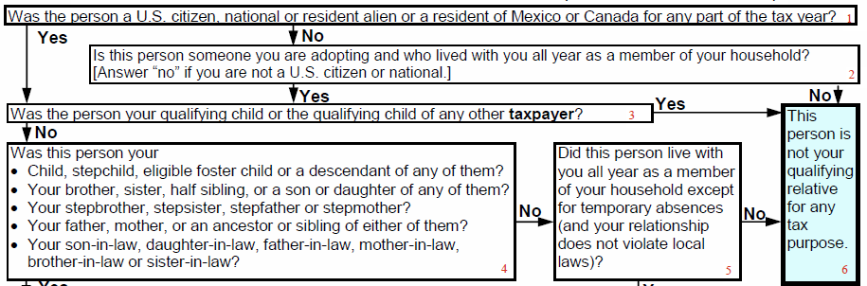
Go back to Chart 2 (Lele as QR of Sam)
Was Lele a US citizen?
Was Lele your qualifying child or the qualifying child or any other taxpayer?
Not Sam’s qualifying child or qualifying relative
  Didn’t meet the support test for children of divorced or separated parents, so not a qualifying child.
  Lele was qualifying child of another taxpayer (both Mary and grandparents), so didn’t meet the tests for qualifying relative.

Slide 51
Confirmed:
Lele is not the qualifying child or qualifying relative of Sam
Lele is qualifying child of her grandparents
  They would not win the tie-breaker with Mary
  But she agreed that they could claim Lele, and their AGI was higher than Mary’s

Slide 52
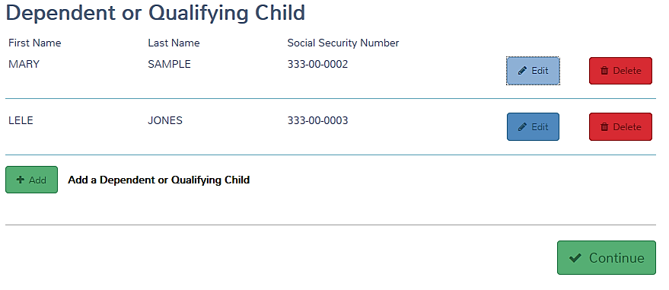
Dependent Section— Grandparent’s Return

Slide 53
Example 5:
Alex (age 28) and his wife, Sara (age 25), were in a bad car accident in February.
When they got out of the hospital in April, they went to live with Alex’s parents while they recovered.
Prior to the accident, Alex and Sara had earned $5,000 each.

Slide 54
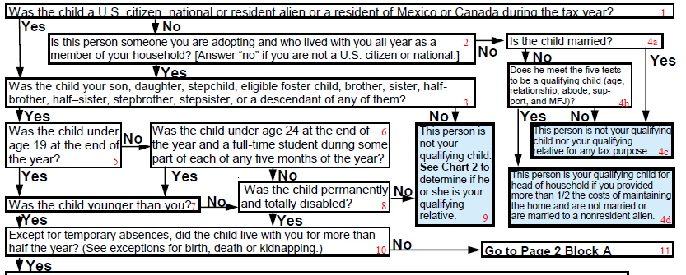
Start with Alex as QC of his parents
Is Alex a US citizen?
Is Alex your son?
Was Alex under age 19 at the end of the year?
Was Alex under age 24 at the end of the year and a full-time student?
Was Alex permanently and totally disabled?
Except for temporary absences, did Alex live with you for more than half the year?
The definition of permanently and totally disabled is unable to work for at least a year. It’s already been more than a year since Alex could work, so we’ll say, “yes.”

Slide 55
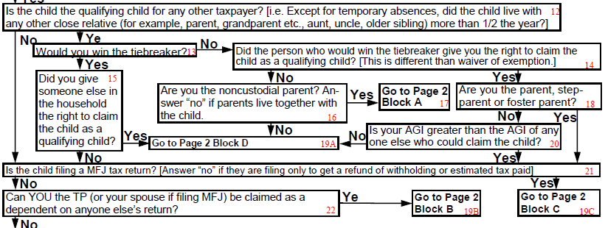
Continue with Alex as QC of his parents
Is Alex the qualifying child for any other taxpayer?
Is Alex filing a MFJ tax return [Answer “no” if they are filing only to get a refund of withholding or estimated tax paid.]
Can you be claimed as a dependent on anyone else’s return?
They have no filing requirement and are filing just to get a refund of withholding, so let’s say “no.” If they claim EIC, we’d say “yes.”
Notes:
If Alex and Sara claimed EIC, we’d have to answer “Yes” to box 21.

Slide 56
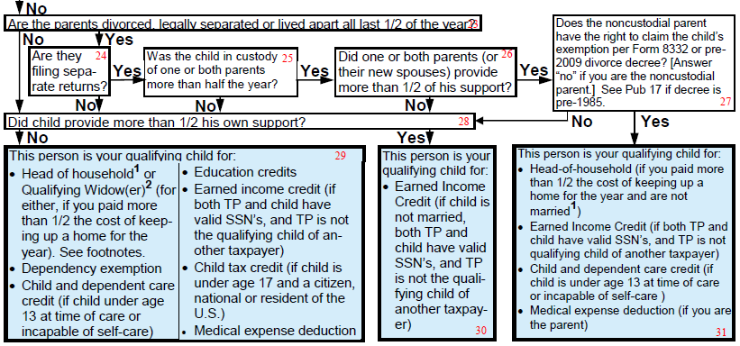
Continue with Alex as QC of his parents
Are Alex’s parents divorced, legally separated or lived apart all last ½ of the year?
Did Alex provide more than ½ his own support?
Include Alex in Dependents Section
Let’s say his parents have provided more than half of his support.

Slide 57
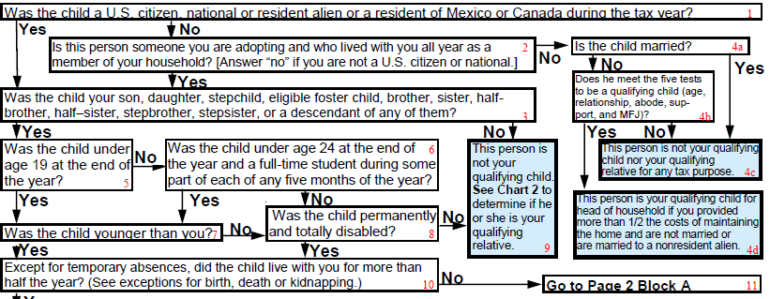
Go on to Sara as QC of Alex’s parents
Is Sara a US citizen?
Is Sara your son, daughter, stepchild, eligible foster child, brother, sister, half-brother, half-sister, stepbrother, stepsister, or a descendant of any of them?
Sara is not your qualifying child. See Chart 2 to determine if she is your qualifying relative.
Does not include daughter-in-law.

Slide 58
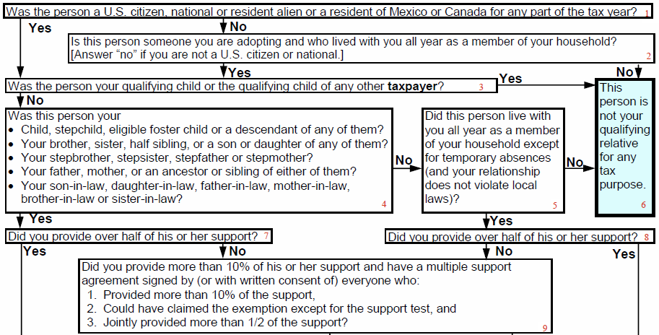
Go to Chart 2 (Sara as QR of Alex’s parents)
Is Sara a US citizen?
Is Sara your qualifying child or the qualifying child of any other taxpayer?
Was Sara your
Child, stepchild, eligible foster child or a descendant of any of them?
Your brother, sister, half sibling, or a son or daughter of any of them?
Your step brother, stepsister, stepfather or stepmother?
Your father, mother, or an ancestor or sibling of either of them?
Your son-in-law, daughter-in-law, father-in-law, mother-in-law, brother-in-law or sister-in-law?
Did you provide over half of her support?
Does include daughter-in-law

Slide 59
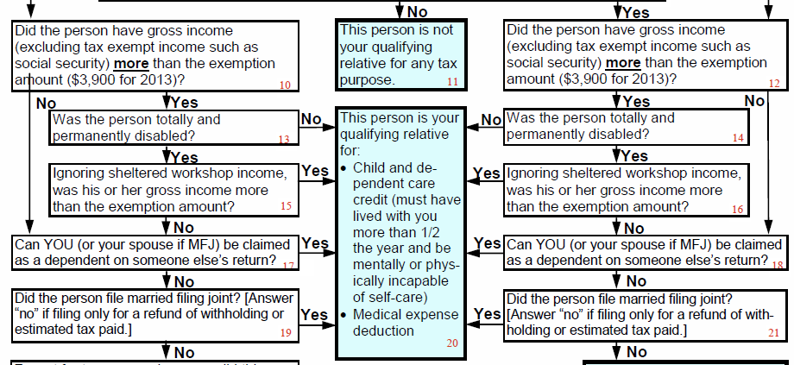
Continue on Chart 2 (Sara as QR of Alex’s parents)
Include Sara’s medical expenses on Sch A and complete Form 2441 if there were dependent care expenses.
Did Sara have gross income more than the exemption amount?
Was Sara totally and permanently disabled?
Ignoring sheltered workshop income, was her gross income more than the exemption amount?
Notes:
We said Sara made $5,000 before the accident. Suppose it had been less than the exemption amount?

Slide 60
Conclusion:
Alex is a qualifying child for his parents for all tax benefits.
If Alex’s parents paid any medical expenses or in-home care for Sara while they worked, they could deduct the medical expenses and claim the dependent care credit. Sara is not their dependent.

Slide 61
Parent’s Return
Medical expenses for both Alex and Sara
Dependent care credit for both
Dependency exemption for Alex
Possible EIC for Alex

Slide 62
Other Requirements
Charts tell you if there is a qualifying person for a given tax benefit
Most tax benefits have other requirements that must be satisfied
These are summarized on page 1 of 2016
tri-fold (page 2 of prior versions)

Slide 63
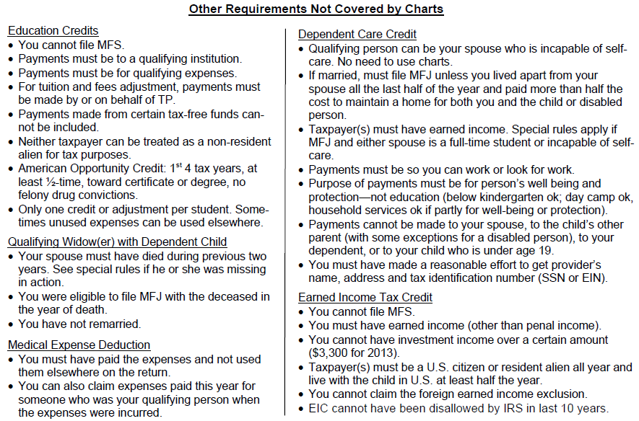
Summary – See Pub 17 for details
You cannot file MFS.
Neither taxpayer can be treated as non-resident alien for tax purposes.
Payments must be so you can work or look for work.
You have not remarried.
Notes:
These are important...and sometimes forgotten

Slide 64
Limitations
You need to know the definitions
Must not forget to check the other requirements
Chart doesn’t cover student loan interest

Slide 65
Corrections
The laminated tri-fold that was distributed Dec 2013 – Jan 2014 has some small errors
  Corrections are available on OSHC
OR
Order a revised version (2016) from Volunteer Portal (Order Tab)

Slide 66
Qualifying Child Charts
Questions?
Comments?

